Slide 1
Learning Hunting behavior in cubs through observation and Imitation
Pragadheeshwaran Thirumurthi
Prarthana G Alevoor

Slide 2
Introduction
Environment
Neural Network
Hypothesis

Slide 3
Aim of the Project
This project aims in learning the hunting behavior of a cub based on the Mother’s hunting behavior
A cub acquires hunting behavior by Imitating the mother
Lion expresses content seeing the cub’s actions.
At a later stage, Cub employs self-learning and transmits learnt behavior to its children
Notes:
This project attempts to create a mapping of the child’s brain with the mother’s brain.
How a cub acquires hunting behavior by imitating the mother
Lion expresses content seeing the cub’s actions

Slide 4
Motivation

Slide 5
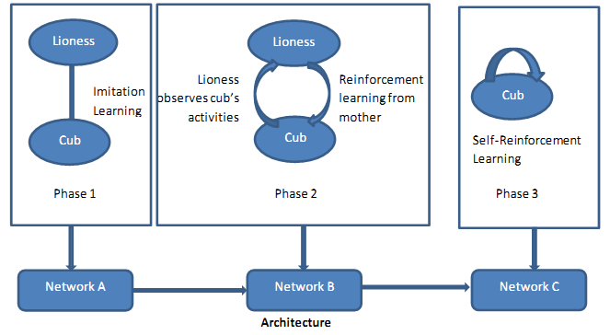
Overall Process

Slide 6
Phase 1
The cub’s neural network does not know the goals (what to hunt, when to hunt) and how to achieve them.
The cub observes the mother.
This builds its neural network and learns the goals and the sequence s of actions for various goals.
Notes:
For example if the parent is hungry and it decides to hunt, then the cub modifies its neural network learns that whenever its hungry it has to hunt.

Slide 7
Phase II
The cub tries to imitate the actions learnt from mother
The cub processes environmental information and chooses appropriate action and executes it.
The cub does not follow lioness’ actions anymore, but applies various actions
(Pounce/Snarl/Claw etc.) learnt in Phase 1.
It uses positive reinforcement learning from the mother to achieve the goal.

Slide 8
Phase III
The cub is detached from lioness and goes hunting on its own
The cub senses new environment and implements its learnt behavior
It uses negative reinforcement learning by itself (during failure it tries to modify its neural network based on the new environment)
A special neuron gets activated when the Cub becomes mother

Slide 9
Neural Model
SENSORS
NEURONS
MOTORS
Energy of the lion
Run
Walk
Idle
VISION
Type of prey
Movement
General
POUNCE
SNARL
CLAW
EAT
SEARCH
Reinforcement
PRAISE
SCOLD
HUNGER
Distance of the prey
Action
Size of the prey

Slide 10
Current Progress
Done till now
Self learning
Mother learns hunting via neural network
Inputs include: normalized (x,y) coordinates of all animats within its range, (x,y) coordinate of the mother, normalized sizes of all the animats in the range, energy of the mother
Output: whether to hunt or not(will be important for the cub to decide whether to hunt a big animal or not)
Reinforcement Learning
When the cub tries to hunt the mother gives positive and negative feedback(praise and scold)
Goals and actions recognized for imitation learning

Slide 11
Current Progress
Usage of Repast which internally uses JOONE neural network framework
Prey does not do learning, but senses environment and tries to escape from Predator
DEMO

Slide 12
Questions ?

Slide 13
Thank You

